Slide 1
Adobe Connect Tutorial “COVID-19 Vaccines for Children” International Webinar November 6, 2021 15:00 (Iran Standard Time)
Shiraz University of Medical Sciences
Vice-Chancellery for Global Strategies and International Affairs
Directorate for International Relations, Accreditations and Rankings

Slide 2
Step 1: Download the Sotfware
Download the Software/APP via these links:
Download for Windows
Download for Mac
Download for iPhone
Download for Android

Slide 3
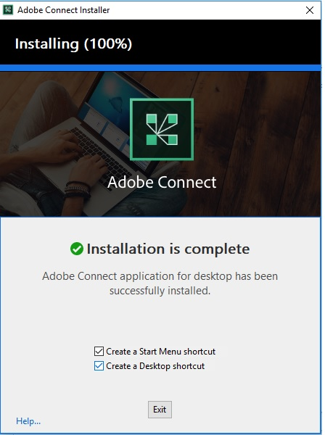
Step 2: Install the Sotfware
The software/APP will be installed in less than one minute
Please create a Desktop shortcut

Slide 4
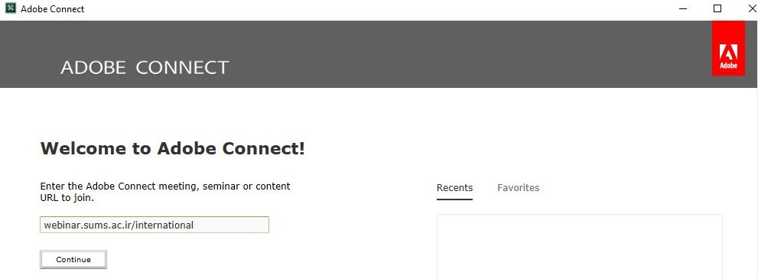
Step 3: Launch Adobe Connect
Launch Adobe Connect from your Desktop
Insert “webinar.sums.ac.ir/international” in the field that appears and continue

Slide 5
Step 4: Choose Your Login Type
Click on “Enter as a Guest”
Type your name
Click on “Enter Room”

